Slide 1

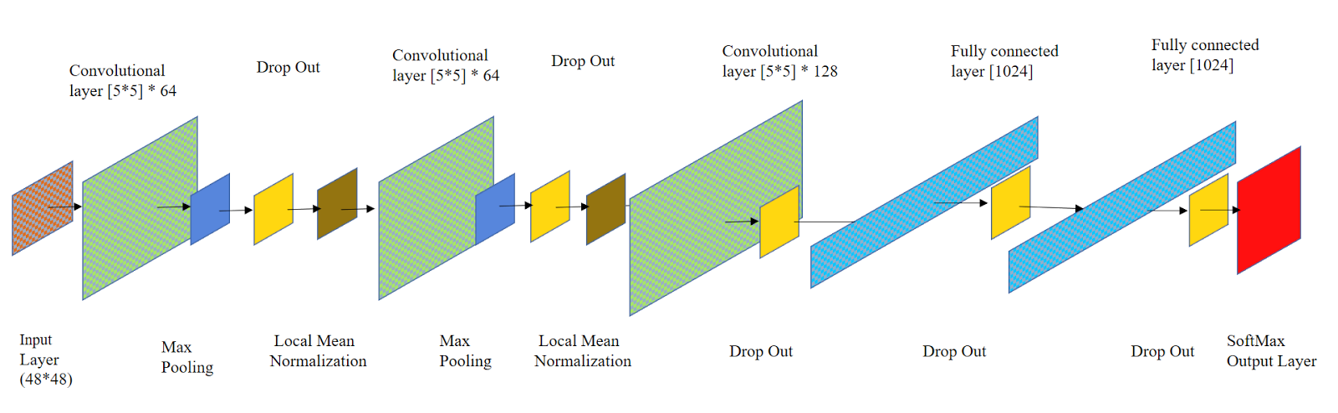
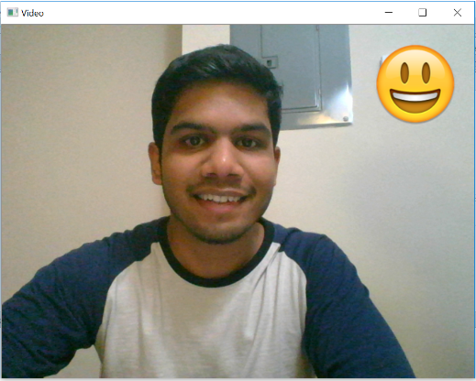
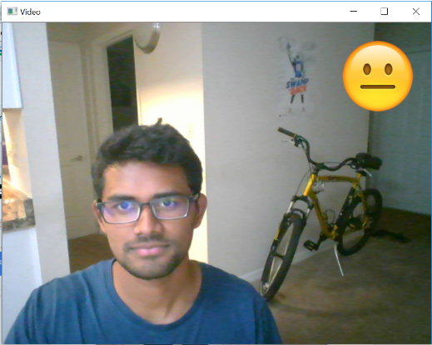
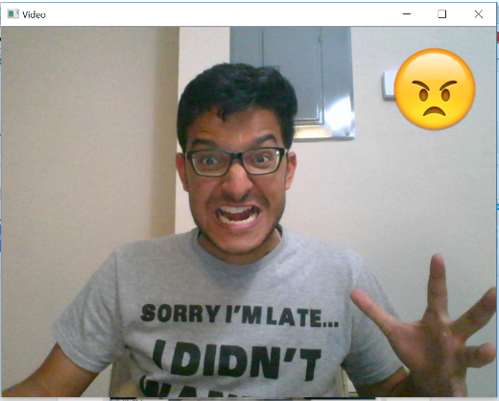

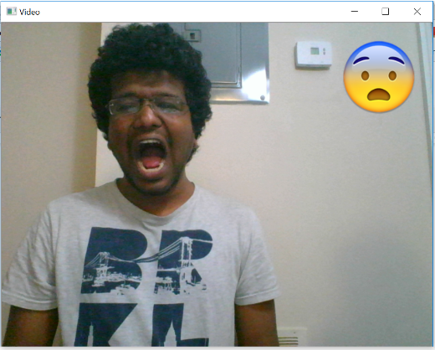

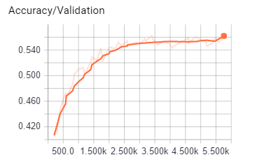
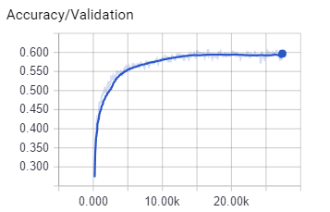
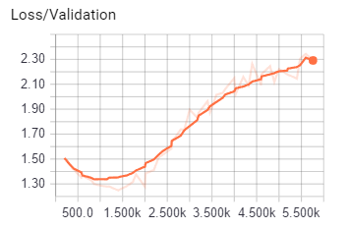
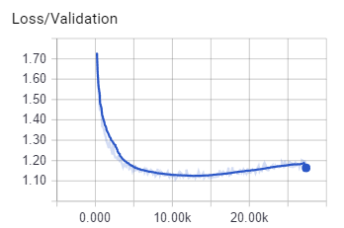
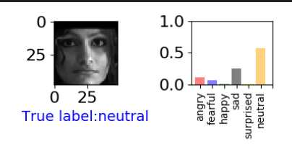


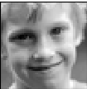

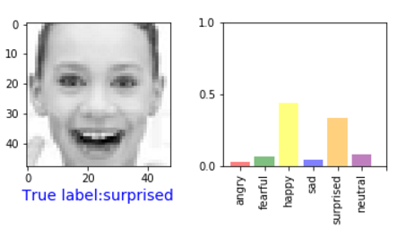
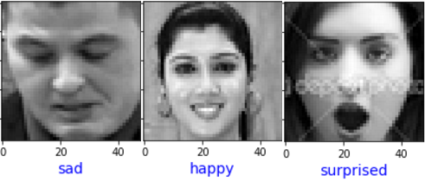
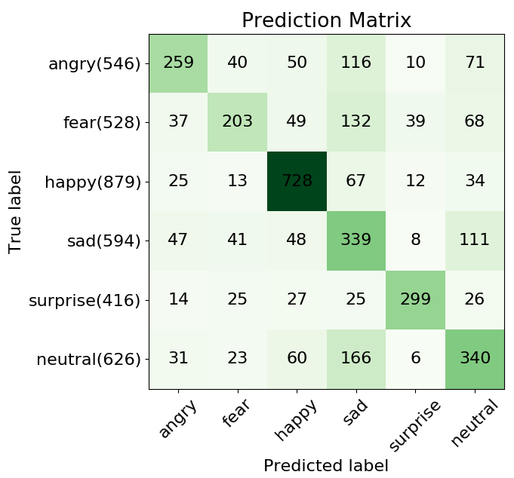
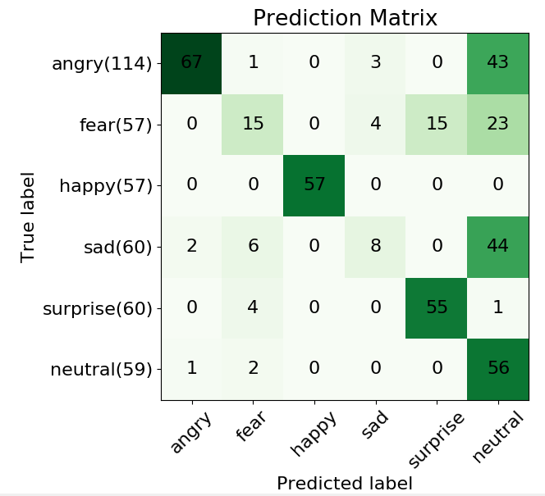
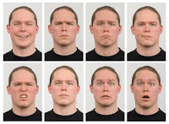
Human Emotions based on Facial Expression using CNN
Chaitanya Maddala, Vineeth Kamisetty, Sandeep Basavaraju
Department of CISE
University of Florida
Introduction
Architecture
Live app
In this project we have developed a deep convolutional neural network model for facial expression recognition. Every facial expression is classified into one of the six expressions considered for this project(Angry, Fear, Happy, Sad, Surprise, Neutral). We implemented conv-fully connected-reLU layers followed by SoftMax. To reduce the overfitting of models, we used dropout and local response normalization. To recognize emotions at real time we capture live images from video frames and this image is sent to the model for prediction , then the model outputs the emotion. The test accuracy obtained is 60.1%
Data Evaluation
Results and Observations
Limitations
FERC (Facial Emotion Recognition Challenge) :
FERC dataset contains 285,709 training images and 7178 testing images (public and private) each 48 x 48 pixels grayscale. The data is in a .csv file containing three columns. First column is the emotion label for image, second column is their pixel values and third column is an indicator for either training, public test or private test set. We chose to use public test set as validation data and private test set as test data. Each image has to be categorized into one of the seven classes that express different facial emotions
RaFD(Radboud Faces Database :
is a high quality faces database and it has eight category of emotions of which only six emotions mentioned above in the paper were considered for the project. For this dataset each emotion was shown with three different gaze directions and each picture was taken from five camera angles simultaneously.
.
One of the limitation is in Image Processing, any shadow or bad lighting on the subject's face will cause incorrect classification of the emotion or sometimes will not detect the face of the subject. Since we are using Haar Cascade classifier, there is a limitation on angle to which the subject can turn the face during live capture, as the classifier will not detect the face of the subject’s face.
ConV + Maxpool + Dropout + Normalization | 5x5x64 Pool : 2x2 Dropout : 0.5
ConV + Maxpool + Dropout + Normalization | 5x5x64 Pool : 2x2 Dropout : 0.5
ConV + Dropout | 5x5x128 Dropout : 0.5
FC + Dropout | 1024 Dropout : 0.5
FC + Dropout | 1024 Dropout : 0.5
Softmax | 6
Activation Map.
Wrong Prediction
Correct Prediction
Conclusions
In this project, we built a convolutional neural network to recognize emotion from grayscale pictures of faces. We experimented with different models, achieving highest test accuracy of 60.1% on a CNN trained from scratch.
Layer architecture of the model.
Table 1. Accuracy table.
Prediction matrix for FERC dataset.
Prediction matrix for RaFD dataset.
Model | Training Accuracy | Validation Accuracy | Testing Accuracy (Top-1 &Top- 2)
Model A | 51.4 | 48.7 | 48.67% & 68.07%
Model B | 45.38 | 45.50 | 43.91% & 61.85%
Model C | 71.15 | 59.68 | 60.1% & 78.37%
Model D | 57 | 51 | 49.18% & 69.10%
Model res | 69 | 59.35 | 58.15% & 75.24%
Accuracy Table
Future Directions
Further improvement on the network’s accuracy and generalization can be achieved by running the model for more epochs on a more powerful GPU. Pre-training on each emotion could lead to a better results and also improves the network’s performance and its robustness. Furthermore, we could train and test our model on different datasets like CK+, JAFFE which could eventually make our model better
References
:
Krizhevsky, I. Sutskever, and G. E. Hinton. ImageNet classification with deep convolutional neural networks. In Advances in neural information processing systems, pages 1097-1105, 2012.
"Dataset: Facial Emotion Recognition (FER2013)" ICML 2013 Workshop in Challenges in Representation Learning, June 21 in Atlanta, GA.
Dropout : Srivastava, N., Hinton, G., Krizhevsky, A., Sutskever, I. & Salakhutdinov, R. Dropout: a simple way to prevent neural networks from overfitting. J. Machine Learning Res. 15, 1929–1958 (2014)
Yann LeCun, Koray Kavukcuoglu, and Cl´ement Farabet. Convolutional networks and applications in vision. In Circuits and Systems (ISCAS), Proceedings of 2010 IEEE International Symposium on, pages 253–256. IEEE, 2010. 2,4
Zeiler, M. D. and Fergus, R. Visualizing and understanding convolutional networks. CoRR, abs/1311.2901, 2013. Published in Proc. ECCV, 2014.

